Slide 1
WHO Information Network for Epidemics
Coronavirus disease (COVID-19)
2019 - 2020
Update #10 21.02.20

Slide 2
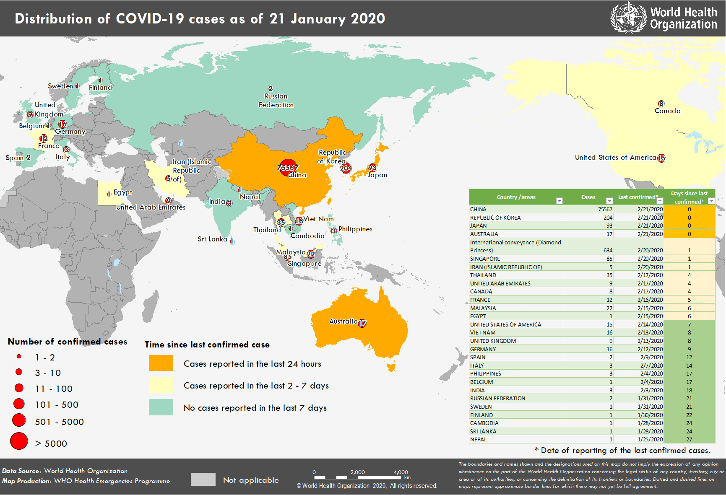
Distribution of cases of COVID-19 as of 21 February Globally: 76,769 confirmed cases and 2,247 deaths

Slide 3
Transmission of COVID-19

Slide 4
Transmission of COVID-19
The spread of COVID-19 between humans is being driven by droplet transmission
The virus is transmitted from a sick person to a healthy person through respiratory droplets when the sick person coughs or talks close to another person.
Current diagnostic tests have yielded positive results from a variety of specimens including throat swabs from asymptomatic people and feces.
These positive results are not a conclusive indication that people are contagious. People may have been exposed and infected but are NOT necessarily transmitting the disease. More investigations into potential other routes of transmission are ongoing.
What has been reported so far it that the main driver of transmission is droplet transmission from people with symptoms.

Slide 5
COVID-19 Risk Communication Package for Healthcare Facilities Developed by the World Health Organization Regional Office for the Western Pacific https://iris.wpro.who.int/handle/10665.1/14482

Slide 6
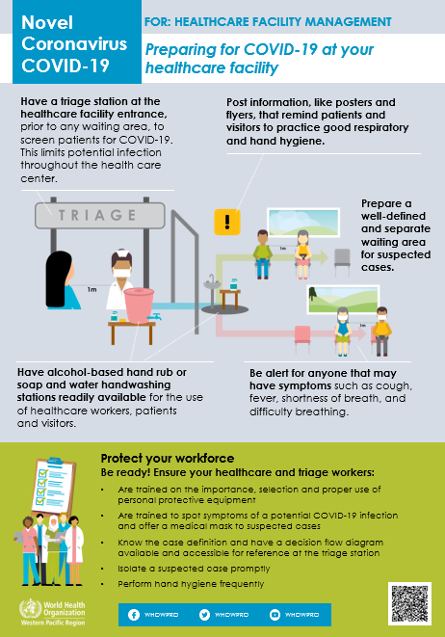
WHO recognizes the essential work of healthcare workers and the responsibility and importance of protecting the healthcare facility workforce
A series of simplified messages and reminders based on WHO’s technical guidance on infection prevention and control in healthcare facilities in the context of COVID-19 https://www.who.int/publications-detail/infection-prevention-and-control-during-health-care-when-novel-coronavirus-(ncov)-infection-is-suspected-20200125
The package includes products such as posters and flyers; it provides healthcare workers (HCWs) and healthcare facility management with the information, procedures, and tools required to safely and effectively work.
An editable ppt is available for adaptation and translation

Slide 7
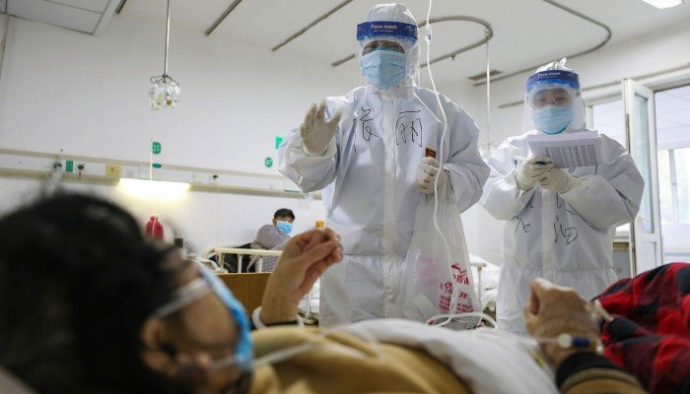
Understanding the risks & protecting health workers
Health workers are at the front line of the outbreak response and are exposed to hazards that put them at risk of infection
Health workers at risk of infection with coronavirus include: ambulance staff, reception staff, health assistants, nurses, doctors, laboratory workers, cleaners
Specific guidance and tools are being developed to protect health workers in different settings: use of PPE, biosafety in laboratories, HCW risk assessment tool
Health workers have rights, roles and responsibilities that will help protect them from infection
https://www.epi-win.com/all-resources/rights-roles-and-responsibilities-of-healthcare-workers
Photo credit: South China Morning Post

Slide 8
Other existing resources related to the health and safety of health workers
Occupational safety and health in public health emergencies: A manual for protecting health workers and responders (English only) https://www.who.int/publications-detail/occupational-safety-and-health-in-public-health-emergencies
ePROTECT respiratory occupational health and safety https://openwho.org/courses/eprotect-acute-respiratory-infections
Work improvement in health services (English, French, Spanish, Portuguese, Arab, Chinese) https://www.ilo.org/sector/Resources/training-materials/WCMS_250540/lang--en/index.htm
ILO Guidelines on Decent Work in Public Emergency Services (English only) https://www.ilo.org/wcmsp5/groups/public/---ed_dialogue/---sector/documents/normativeinstrument/wcms_626551.pdf

Slide 9
Stigma is harmful to people and to the outbreak response

Slide 10
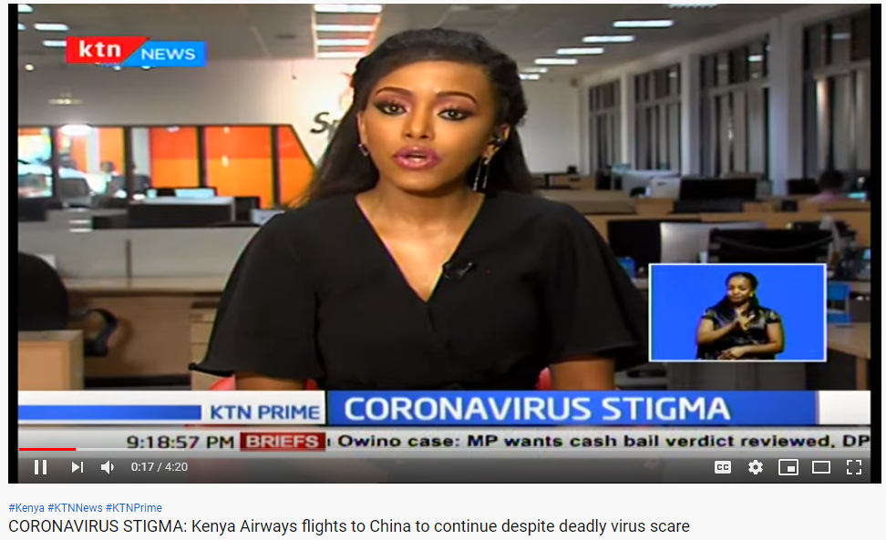
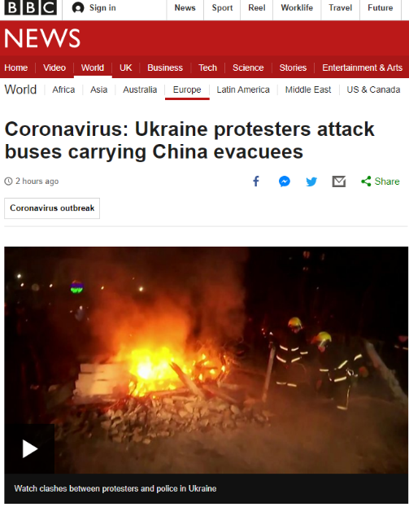
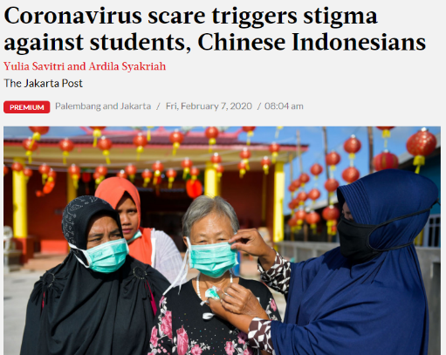
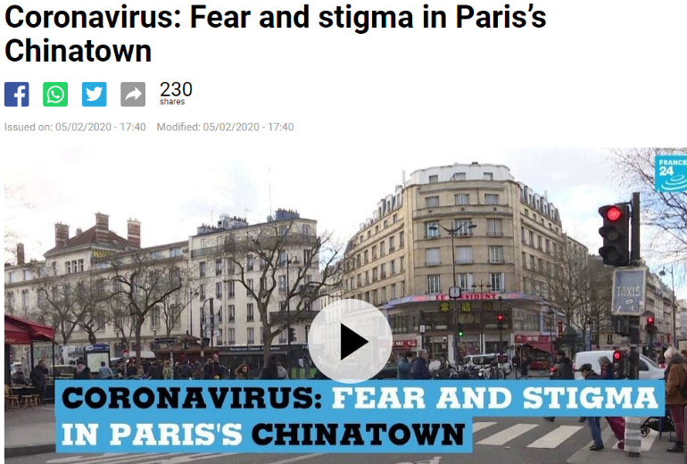
Stigma stories
https://www.thejakartapost.com/news/2020/02/06/coronavirus-scare-triggers-stigma-against-students-chinese-indonesians.html
https://www.bbc.com/news/world-europe-51581805
https://www.france24.com/en/20200205-coronavirus-fear-and-stigma-in-paris-s-chinatown
https://www.scmp.com/comment/letters/article/3049145/coronavirus-fears-spread-spare-thought-chinese-battling-stigma

Slide 11
The impact of stigma
Stigma can….
drive people to hide the illness to avoid discrimination.
stop people from seeking health care immediately and
prevent people from adopting healthy behaviors.
A guide to preventing and addressing social stigma, developed by IFRC, UNICEF and WHO will be published soon.
Dr. Tedros
“This is the time for facts, not fear.
This is the time for science, not rumors.
This is the time for solidarity, not stigma.
𝑾𝒆 𝒂𝒓𝒆 𝒂𝒍𝒍 𝒊𝒏 𝒕𝒉𝒊𝒔 𝒕𝒐𝒈𝒆𝒕𝒉𝒆𝒓."

Slide 12
More information
WHO sources:
COVID-19 website: https://www.who.int/health-topics/coronavirus
WHO Travel Advice: https://www.who.int/ith/en/
Email: EPI-WIN@who.int
Website: www.EPI-WIN.com

